Slide 1
Understanding the Neural Tangent Kernel
Lumin
18th/Nov/2021

Slide 2
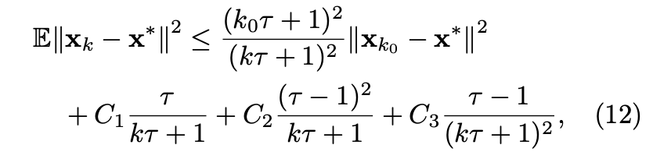
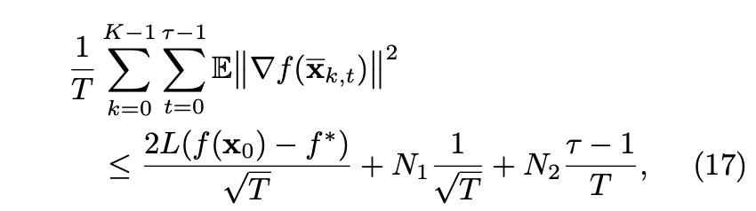
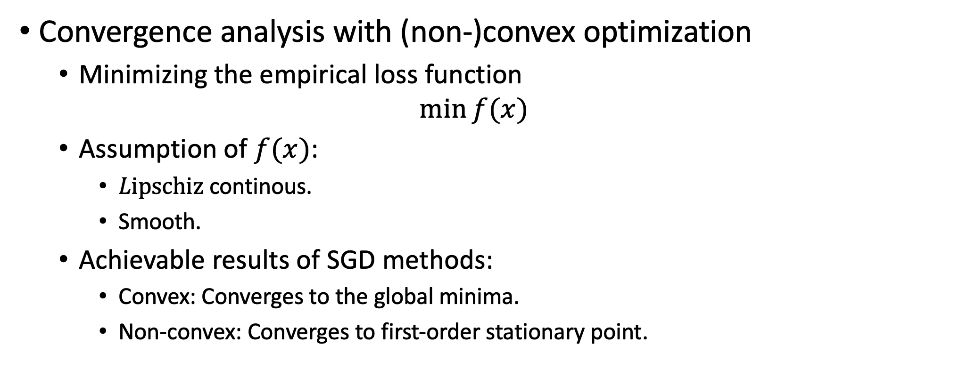
Introduction
Convergence analysis with (non-)convex optimization
Minimizing the empirical loss function
$$\min{f(x)}$$
Assumption of $f(x)$:
$Lipschiz$continous.
Smooth.
Achievable results of SGD methods:
Convex: Converges to the global minima.
Non-convex: Converges to first-order stationary point.
Convex
Non-Convex

Slide 3
Introduction
Can we remove the assumptions and get a better results for non-convex loss function?
Neural Tangent Kernel
Analyzing the neural Networks in the infinite width limit.
NN simplifies to linear models with a kernel called Neural Tangent Kernel.
Convergence to 0 training loss.

Slide 4
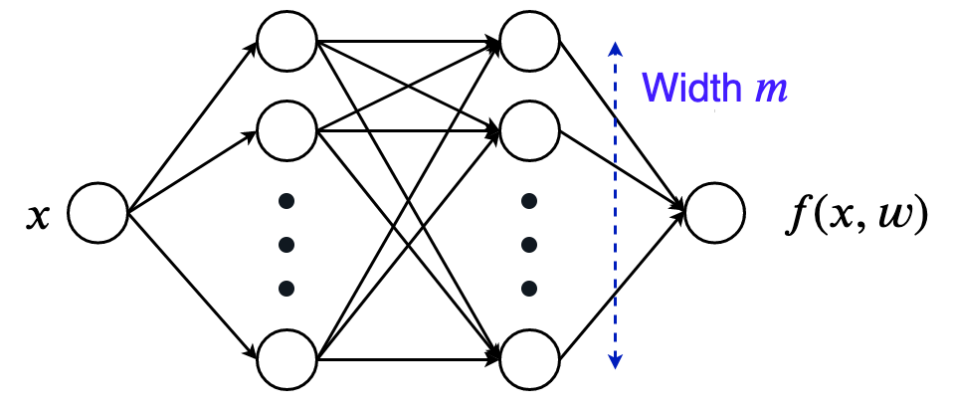
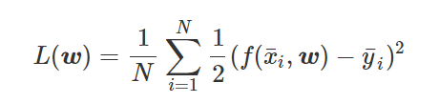
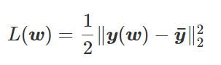
Setup
A simple 1-D input, 1-D output NN with two-layer Relu network with m neurons.
Full-batch gradient descent on the least-square loss
Vectorize the expression and drop the constant:

Slide 5
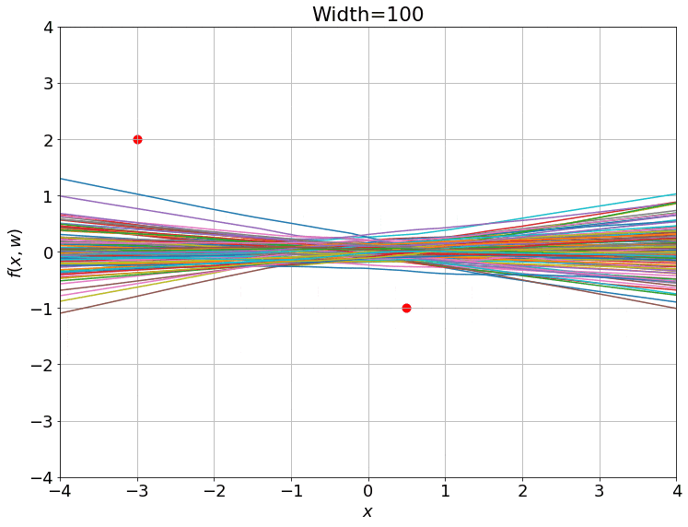
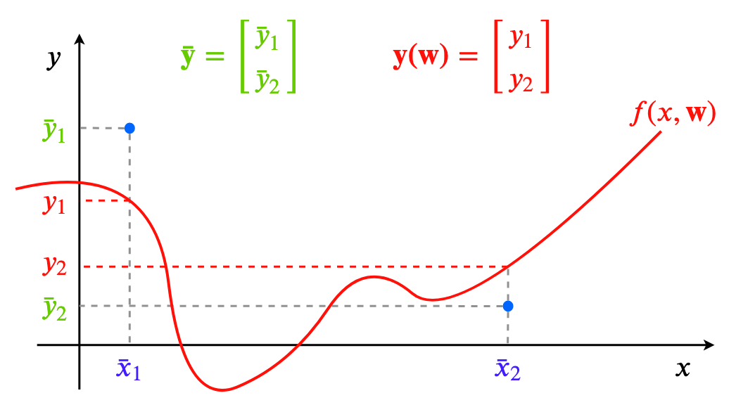
Setup
2-data point example
Training 100 ReLU nets using gradient descent on square loss.

Slide 6
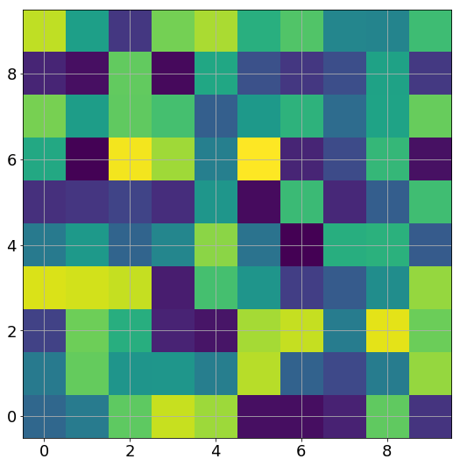
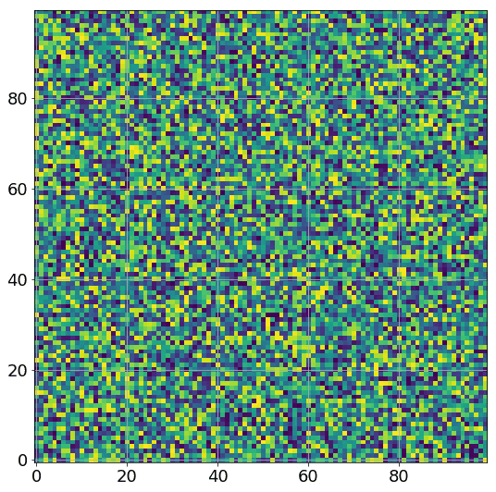
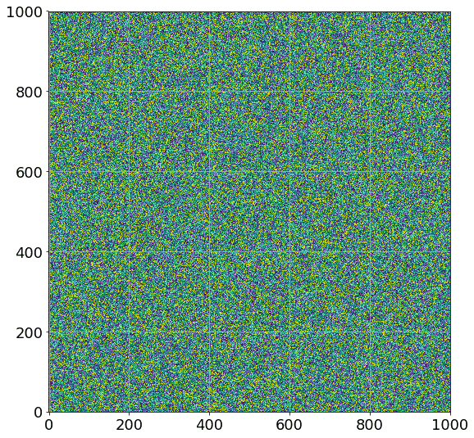
Setup
A GIF of the weights between the two hidden layers (an m×m matrix) as the training progresses:
Animation of weight matrices during training. You might be able to see some changes only for width 10, but greater widths look completely static

Slide 7
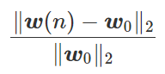
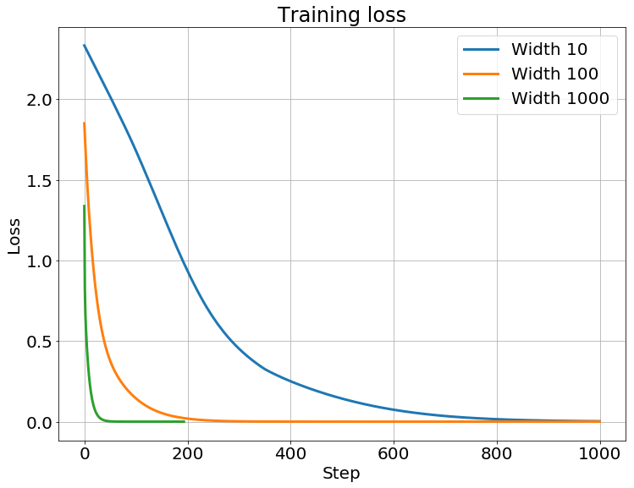
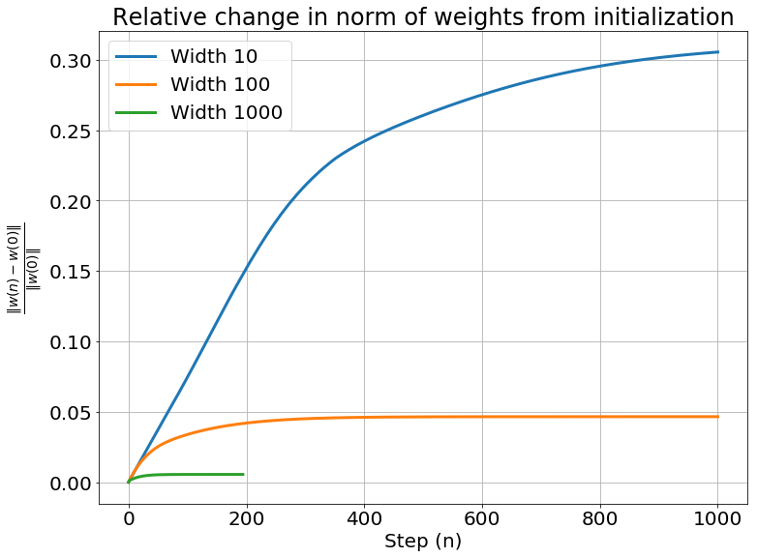
Setup
Weight change:

Slide 8
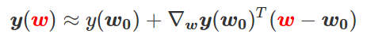
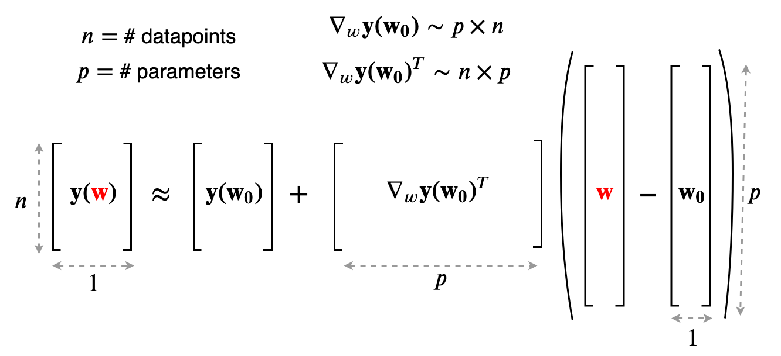
Taylor-expand
First order Taylor-expand around the initialization
0
A simple linear function of the weights

Slide 9
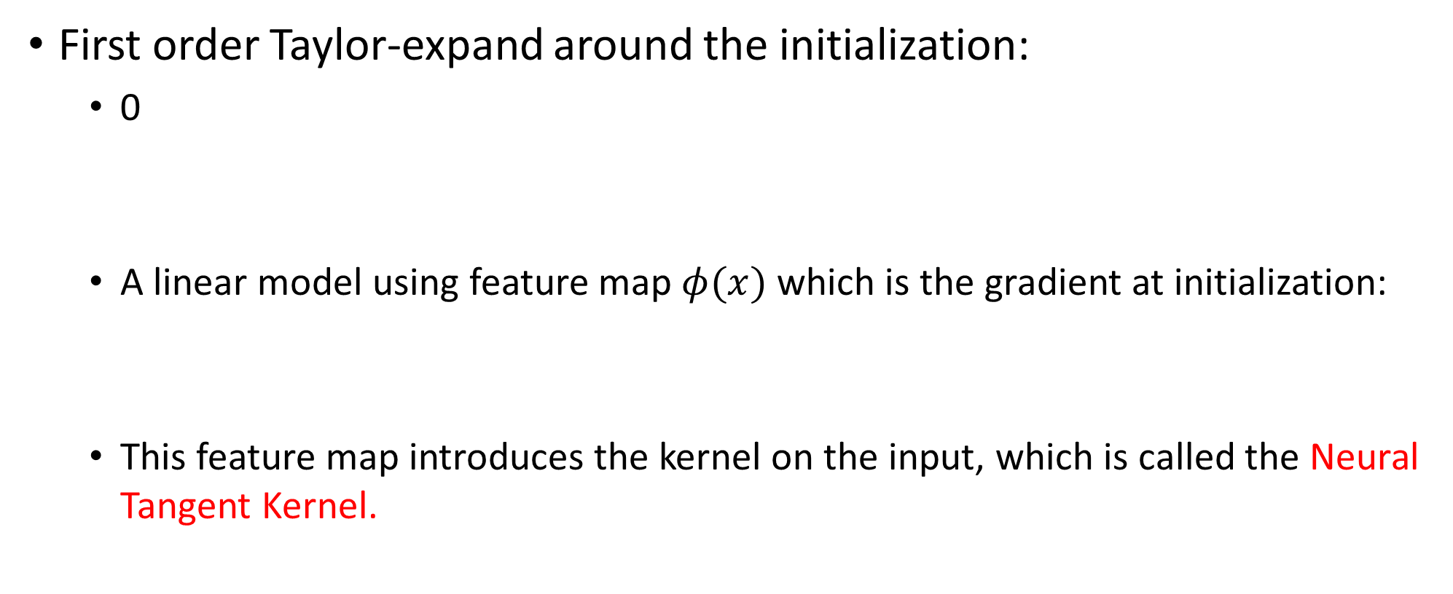
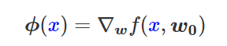
Taylor-expand
First order Taylor-expand around the initialization:
0
A linear model using feature map $φ(x)$ which is the gradient at initialization:
This feature map introduces the kernel on the input, which is called the Neural Tangent Kernel.

Slide 10
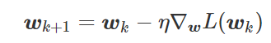
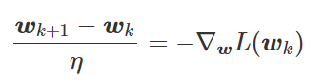
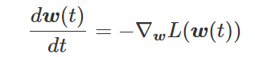
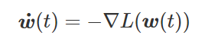
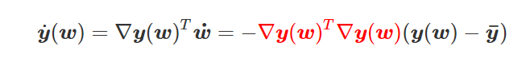
Training dynamics
Gradient Flow
0
Take the learning rate to be infinitely small:
0
Substitute the square loss:

Slide 11
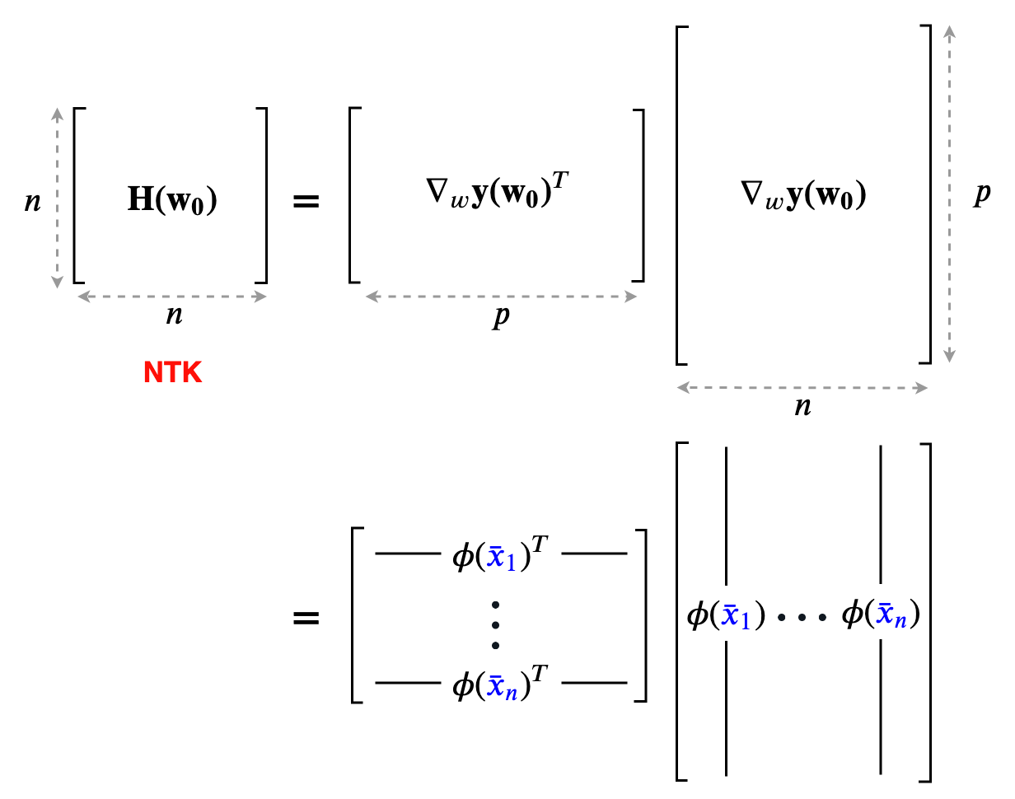
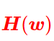
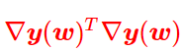
Training Dynamics
Neural Tangent Kernel
=

Slide 12
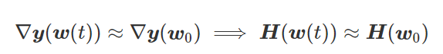
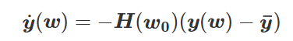
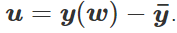
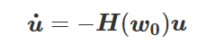
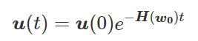
Training Dynamics
When the linear approximation holds:
0 (kernel regime)
Linear ODE
0
Solution:

